Slide 1
Introduction to Data Mining
Chapter 1

Slide 2
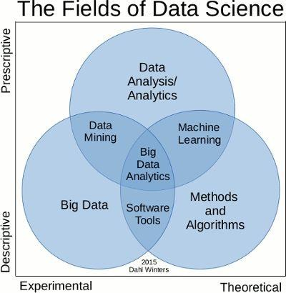
Introduction-Data Streams
Notes:
This generated huge amount of data can be considered as data streams since it is generated continuously at high speed over the time

Slide 3
Data Mining Definition I
The nontrivial extraction of hidden, previously unidentified, and potentially valuable knowledge from data
A variety of techniques such as neural networks, decision trees or standard statistical techniques to identify nuggets of information or decision-making knowledge in bodies of data, and extracting these in such a way that they can be put to use in areas such as decision support, prediction, forecasting, and estimation.

Slide 4
Data Mining Definition II
Finding hidden information in a database

Slide 5
Hidden Information
Number of years of experiences
Great secret recipes
Success Factors

Slide 6
Database Processing vs. Data Mining Processing
Query
  Well defined
  SQL
Query
  Poorly defined
  No precise query language
Data
  Operational data
Data
  Not operational data
Output
  Precise
  Subset of database
Output
  Fuzzy
  Not a subset of database

Slide 7
Query Examples
Database
Data Mining
Find all credit applicants with surname name of Lee.
  Identify customers who have purchased more than $100,000 in the last year.
        Find all customers who have purchased bread
  Find all credit applicants who are good credit risks. (classification)
        Identify customers with similar eating habits. (Clustering)
        Find all items which are frequently purchased with bread. (association rules)

Slide 8
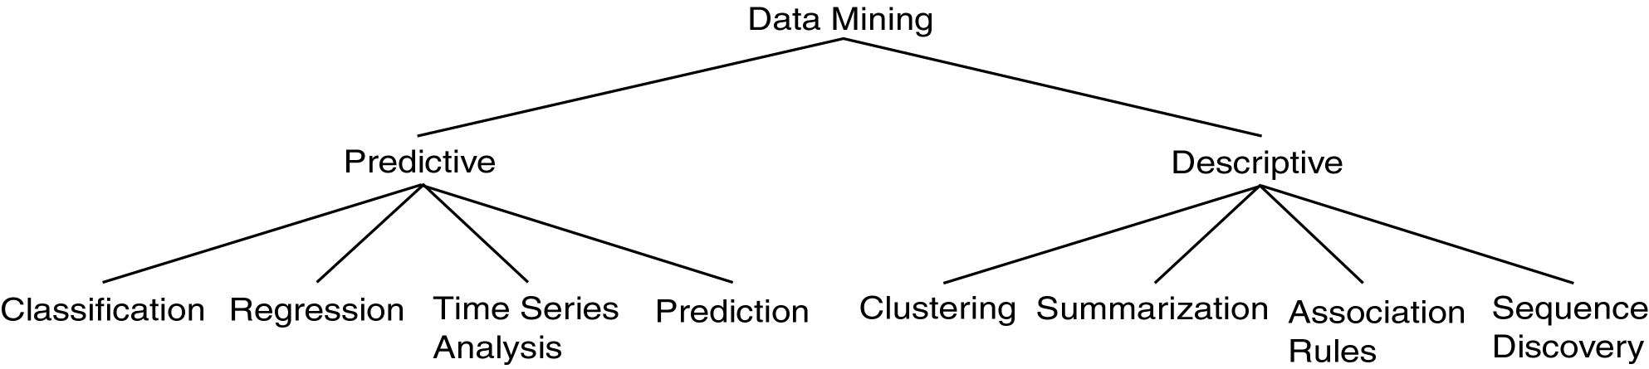
Data Mining Models and Tasks

Slide 9
Data Mining vs. KDD
Knowledge Discovery in Databases (KDD): process of finding useful information and patterns in data.
Data Mining: Use of algorithms to extract the information and patterns derived by the KDD process.

Slide 10
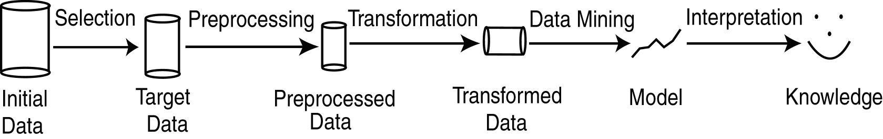
KDD Process
Modified from [FPSS96C]
Selection ( Pre-Mining 1): Obtain data from various sources.
Preprocessing (Pre-Mining 2) : Cleanse data.
Transformation (Pre-Mining 3): Convert to common format. Transform to new format.
Data Mining: Obtain desired results.
Interpretation/Evaluation (Post-Mining): Present results to user in meaningful manner.

Slide 11
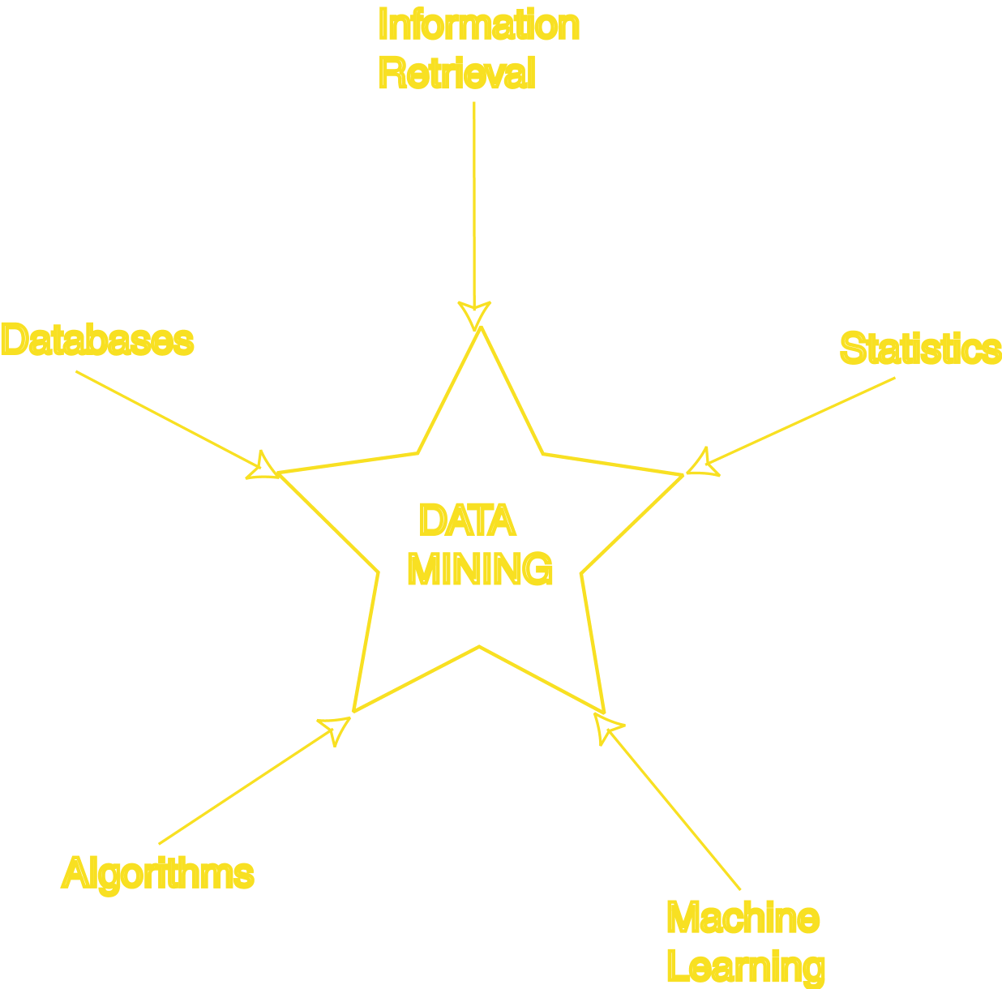
Data Mining Development
Similarity Measures
Hierarchical Clustering
IR Systems
Imprecise Queries
Textual Data
Web Search Engines
Relational Data Model
SQL
Association Rule Algorithms
Data Warehousing
Scalability Techniques
Bayes Theorem
Regression Analysis
EM Algorithm
K-Means Clustering
Time Series Analysis
Algorithm Design Techniques
Algorithm Analysis
Data Structures
Neural Networks
Decision Tree Algorithms

